Slide 1
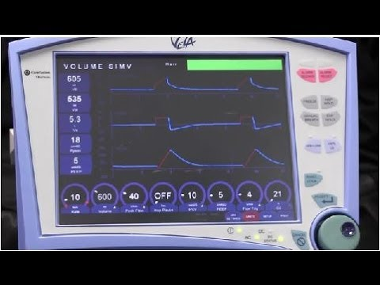
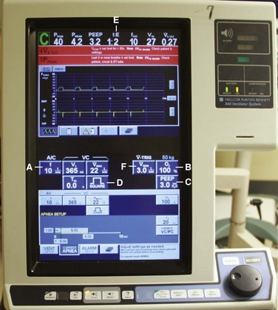
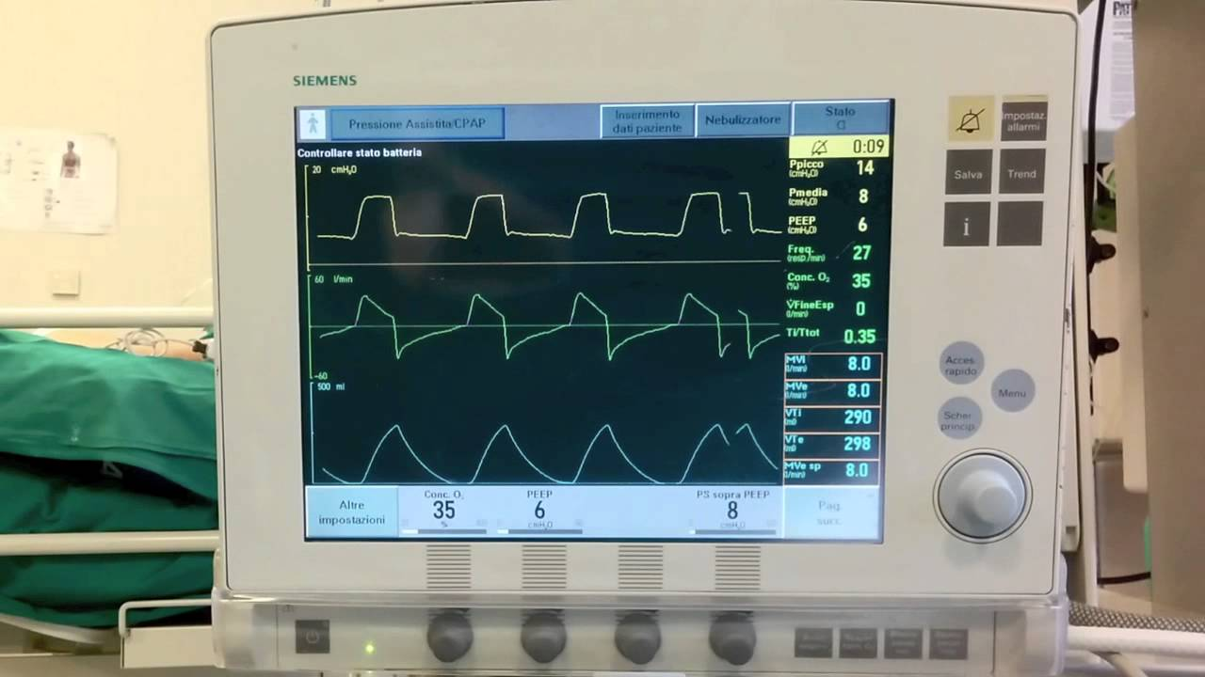
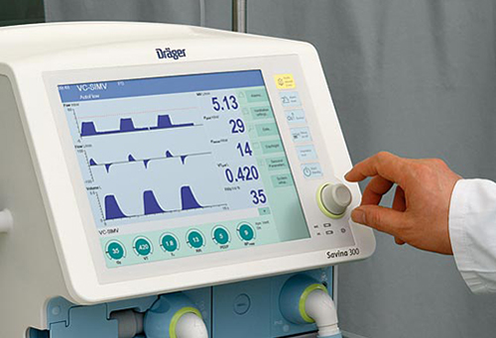
KGMU CoViD-19 EPIDEMIC: BASICS OF MECHANICAL VENTILATION
Dr Suhail Sarwar Siddiqui
MD, DM, EDIC
Assistant Professor
Department of Critical Care Medicine
King George’s Medical University (KGMU) Lucknow

Slide 2
Contents
Sensitization
Background of MV
Indications
Classification
Basic design and concepts: ventilator design and modes
Initial ventilator setting
Troubleshooting
Monitoring during MV
Complications
Weaning from MV

Slide 3
Sensitization
CoVid -19: Pandemic/national disaster
All routine services closure
Gearing up to fight the pandemic
All the forces unite
Know your armamentarium
Protect yourself

Slide 4
Background of MV

Slide 5
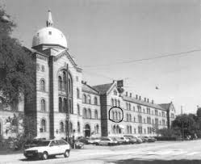
Background of MV
Bjorn Ibsen (1915-2007)
Municipal Hospital, Copehagen

Slide 6
Indications of Mechanical Ventilation
Poor Oxygenation
Raised CO2 level
Increased Work of breathing

Slide 7
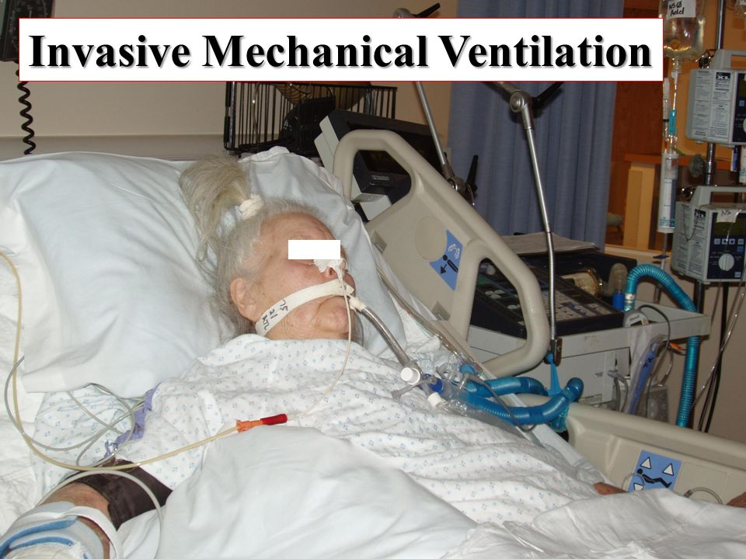
Classifications of MV
Non Invasive Ventilation

Slide 8
Basic design and concepts: modes
Controlled/ /Mandatory breaths:
Volume Control Ventilation (VCV)
Pressure Control Ventilation (PCV)
Supported breaths:
Pressure support ventilation (PSV)
Mixed breaths:
Synchronized Intermittent Mandatory Ventilation (SIMV)
Assisted modes

Slide 9
Basic design and concepts
All ventilators do only one thing: Push in air in inspiration
Compressor +Two valves
Inspiration
I. valve =Open
E. valve = Closed
Insp Pause = both valves closed
Expiration
I. valve = Closed
E. valve = Open
Exp Pause (PEEP) = both valves closed

Slide 10
Phase variables of a Breath
Limit
Inspiration
Cycle
Trigger
Time
Pressure
Flow
Flow (L/min)
Cycle
Time/Volume
Pressure
Flow
Time (sec)
Trigger
Expiration
Courtesy: Prof J V Divatia

Slide 11
Triggering
Pressure (cmH₂0)
Patient
Machine
Time (sec)
Courtesy: Prof J V Divatia

Slide 12
Inspiration - Limit
If one or more inspiratory variables rises no higher than some preset value
However inspiration is not terminated because the limit is reached
It remains at that level till changeover to expiration occurs

Slide 13
Inspiratory Plateau Pressure Volume Controlled Ventilation
PIP
P Plateau by End inspiratory hold maneuver
P_{aw} (cm H₂O)
Exhalation Valve Opens
P_{plateau}
_{(Palveolar)}
Inspiratory Pause
Expiration
Time (sec)
Inspiratory
Hold
Begin Inspiration
Begin Expiration
Courtesy: Prof J V Divatia

Slide 14
Inspiration
Peak inspiratory flow rate
PIFR
Inspiratory valve closes
Inspiration
Beginning of expiration
exhalation valve opens
Inspiratory
Time
TI
Expiratory Time
T_{E}
Flow (L/min)
Insp
Pause
Time (sec)
Beginning of inspiration
exhalation valve closes
Expiration
Courtesy: Prof J V Divatia

Slide 15
Volume vs. Pressure Control
Volume Preset
Set parameter is the tidal volume; airway pressure is variable
Constant tidal volume in the face of changing lung characteristics
Patient-ventilator asynchrony due to fixed flow rate
No leak compensation
Pressure Preset
Set parameter is airway pressure; tidal volume delivered is variable
Tidal volume varies with changes in lung characteristics
Flow will vary according to patient's demands
Compensates for leaks

Slide 16
CMV
All breaths are mandatory
Preset frequency, inspiratory time/Inspiratory flow
Pressure or volume control
Trigger: Time
Limit: Volume, flow or pressure
Cycle: Time, volume

Slide 18
Like CMV
Each additional assisted breath at prefixed tidal volume or pressureTrigger: ventilator or patient
Limit: Flow / volume or Pressure
Cycling: volume or time
Assist
Control

Slide 19
SIMV
IMV
Machine triggered breaths with spontaneous breaths allowed in between
SIMV
Synchronised mandatory breaths with spontaneous breaths allowed in between
Ventilator creates a time window around the scheduled delivery of mandatory breath
If a patient effort is detected, it synchronises the machine breath with the patient’s inspiration
If no patient effort is detected, it delivers a breath at the scheduled time

Slide 20
SIMV Mode
Flow
(L/min)
Pressure
(cm H₂O)
Volume
(ml)
Time (sec)
Courtesy: Prof J V Divatia
Spontaneous Breath

Slide 21
Pressure Support
Completely spontaneous mode in which patient triggers each breath
On inspiration patient exposed to a preset pressure
Inspiration is terminated when the flow rate reaches a minimum level or % of peak flow
Trigger: Patient
Limit: Pressure
Cycling: flow

Slide 22
PSV
Flow
(L/m)
Set PS level
Rise
Rise
Time
Pressure
(cm H₂O)
Volume
(mL)
Time (sec)
Courtesy: Prof J V Divatia

Slide 23
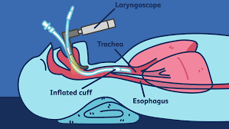
Initiating Mechanical Ventilation
Check ventilator assembly: power connection, circuit connection, HME filter catheter mount, gas connections
Switch on ventilator, check on test lung
Begin Preoxygenation (aerosol precaution)
Watch for Hypotension
Infuse Fluids
Start Mechanical Ventilation
A/C:TV=350-450, RR=20-30, FIO2= 60-100%
Peak Flow rate 40-60 l/min
PEEP=5-10, I:E=1:2, Sens= -0.8 - 2

Slide 24
Predicted Body Weight, TV and Minute Ventilation
The predicted body weight calculated as
Males: 50+0.91(height cm -152.4);
Female: 45.5+0.91( height cm -152.4).
Calculate predicted body weight (PBW)
Males = 50 + 2.3 [height (inches) - 60]
Females = 45.5 + 2.3 [height (inches) -60]
TV= 6 ml/kg PBW
MVm= 4XBSA
MVf= 3.5XBSA
MV= 100 ml/kg of PBW

Slide 25
GOALS
OXYGENATION GOAL: PaO₂55-80 mmHg or SpO₂ 88-95%
PLATEAU PRESSURE GOAL: ≤ 30 cm H₂O
pH GOAL: 7.30-7.45
Acidosis Management: (pH < 7.30)
If pH 7.15-7.30: Increase RR until pH > 7.30 or PaCO² < 25 (Maximum set RR = 35).
If pH < 7.15: Increase RR to 35.
If pH remains < 7.15, TV may be increased in 1 ml/kg steps until pH > 7.15 (Pplat target of 30 may be exceeded). (Max TV =8, Min TV=4 ml/kg)
Alkalosis Management: (pH > 7.45) Decrease vent rate if possible.

Slide 26
Other settings
I:E=1:2, Vt: 500 ml, RR= 20/min
Inspiratory flow rate=?
Total cycle time (TCT)= 60 sec/RR=60 sec/20= 3
Required I:E= 1:2= hence 1+2=3, divide 3 seconds into 3 parts.
So Ti=1 sec, Te=2 sec.
So to deliver 500 ml in 1 seconds inspiratory flow should be 0.5 L/sec. Which is equal to 30 litre/min.

Slide 27
Initiating Mechanical Ventilation
Confirm bilateral chest expansions
Start Sedation +/- Relaxants
Insert Central Line, Foleys Catheter & NG Tube
Check X Ray & ABG in 10-20 Min.
Start Anti Gastritis and DVT Prophylaxis & Eye Care

Slide 28
Monitoring on MV
Heart rate
SpO2
Respiratory rate
Pattern of respiration and signs of respiratory distress
Blood pressure
ETCO2
Expired tidal volume: equal to set tidal volume (leaks)
Peak pressure, Plateau pressure (< 30 mm Hg)
TREND IS YOUR FRIEND

Slide 29
Types of Waveforms
Scalars and Loops:
Scalars: Plot pressure, volume, or flow against time. Time is the x-axis
Loops: Plot pressure or flow against volume. (P/V or F/V). There is no time component.

Slide 30
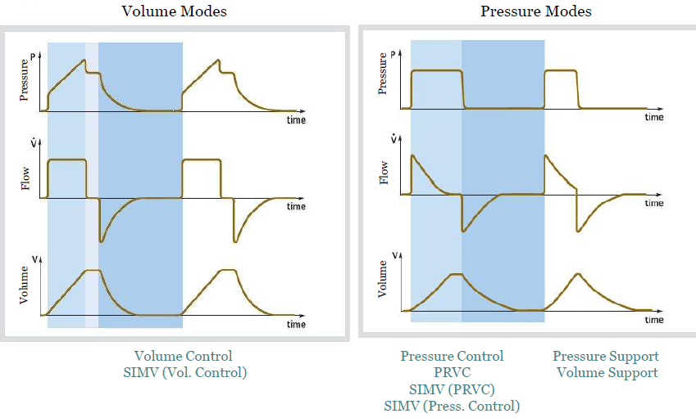
Types of Scalars

Slide 31
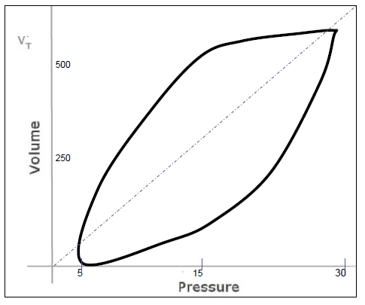
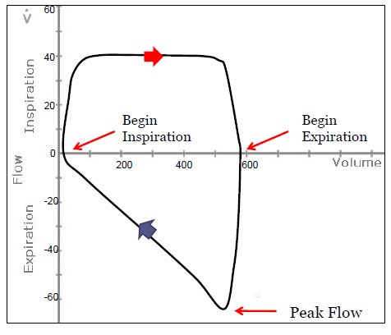
Types of Loops
P-V Loop
F-V Loop

Slide 32
Ventilator alarms and troubleshooting
Alarms | Priority | Causes | Steps
Electrical power/ gas delivery/ Battery | Highest | Disconnection of power supply or oxygen source | Connect the power or Oxygen source
Low airway pressure | High | Disconnection or volume leak, in appropriate alarm setting | Connect ventilator, check alarm setting
High airway pressure | High | Obstruction to flow, pneumothorax and other compliance problem (fluid overload/ abdominal hypertension) | Check for Ppeak and Pplat (diff <3-5) if both high: Compliance problem (pneumothorax etc) If Ppeak and Pplat (diff>3-5) : Resistance problem (tube/circuit block etc): suction/change tube, bronchodilator
Low Expired Vt | High | ETT cuff leak, Circuit leak, leak from HME filter, leak from ICD | Check/change ETT, Circuit, HME filter, ICD
High RR High PEEP | Moderate | Blocked tube/bronchoconstriction | Suction/bonchodilation

Slide 33
Management of other problems
Hypoxemia: check for disconnection, Increase Fio2, Call for help, check for tube block, fluid overload, check air entry, patient ventilator asynchrony
DOPE:
D: Disconnection/ Dislodging
O: Obstruction,
P: Pneumothorax
E: Equipment failure
There may exist multiple problems

Slide 34
Criteria for consideration for Weaning/discontinuation
Underlying disease stable or improving
PaO2 / FiO2 > 200
PEEP < 5-8 cmH2O
FiO2 < 0.5
Reliable respiratory drive
Stable CVS
Minimal pressors or inotropes
Absence of myocardial ischemia
Capable of initiating inspiratory effort

Slide 35
Underlying condition has
Resolved or improved and there is no other condition mandating MV
Daily screening of RS function
Weaning
Not Ready
Ready
MV and
Daily screening
SBT
T-piece or PSV
30min is enough
Tolerated
Not tolerated
Gradual Withdrawal
Esteban. AJRCCM 1997;156:459
Once-daily T-piece
PSV
Esteban. AJRCCM 1999;159:512
Ely. NEJM 1996;335:1864

Slide 36
Difficult weaning
A: Airway and lung dysfunction (resistance/compliance problem)
B: Brain dysfunction (delirium, depression)
C: Cardiac dysfunction (Cardiomyopathy)
D: Diaphragm/ respiratory muscle
E: Endocrine and metabolic (hypokalemia, hypomagenesimia, hypophosphatemia, malnutrition, hypothyroidism, met. Acidosis, fever)
Heunks et al Critical Care; 2010

Slide 37
Complications of MV
Airway management related complications
Hypotension
Pneumothorax/Subcutaneous emphysema
Ventilator induced lung injury
Ventilator associated pneumonia

Slide 38
CARRY HOME MESSAGE
CoViD-19 patients usually present to ICU with ARDS.
For ventilating these patients Tidal volume (TV) should be calculated by 6 ml/kg PBW. (TVmax=8 ml/kg, TVmin=4 ml/kg)
Ventilating a patient with ARDS: Low TV, High RR, High PEEP and Plateau pressure < 30 cm H2O.
One should be aware of monitoring and troubleshooting of mechanical ventilator.
Patient should be initiated on Controlled or assist control mode of MV and once recovers can be weaned using spontaneous breathing trial.
In patients with difficult weaning ascertain and correct the cause.

Slide 39
THANK YOU

